Slide 1
”Gigolo and Gigolette ”
by Somerset Maugham

Slide 2
Plot
Syd Cotman,a former gigolo, has a drink with Sandy Westcott at the bar.During their talk,we are told about his wife,Stella,who was a gigolette in the past as well,however now she is making a packet owing to her spine-tingling performance.It is jumping from a tall ladder down into the narrow and shallow tank.Right before she dives, the surface is set alight by her husband.Later we are introduced to some other characters and given their portrayal: ” There was an Italian countess who was neither Italian nor a countess”.Then it is time for us to witness Stella’s stunt.Following her trick,we get to know an bizarre old couple,who used to be in profession.They have a small chat with our couple,which is an eye-opener for Mrs Cotman as she refuses to jump once more due to the fear of killing herself and some profound revelation.
In the end she decides to perform.

Slide 3
”I mustn’t disappoint my public ”
I want to be in at the death. She’s bound to kill herself one of these nights and I don’t want to miss that if I can help it
‘I like to be next door to the tank,’ said Sandy, ‘so that I can see her face.’ ‘Is she pretty?’ asked the Countess. ‘It’s not that. It’s the expression of her eyes. She’s scared to death every time she does it
But you know what the public is, give ’em a good thing and they go mad over it, only they want change; ’owever good it is, they get sick of it and then they won’t go and see it any more. It’ll ’appen to you, my dear, same as it ’appened to me. It comes to all of us.
You’re not going to do a show tonight?’ ‘Tonight, and every night till I kill myself. What else is there?
You can’t disappoint your public like that.’ ‘That filthy public. Swine who eat too much and drink too much. A pack of chattering fools with more money than they know what to do with.
What do they come and see me over and over again for? On the chance they’ll see me kill myself. And a week after I’m dead they’ll have forgotten even my name. That’s what the public is.

Slide 4
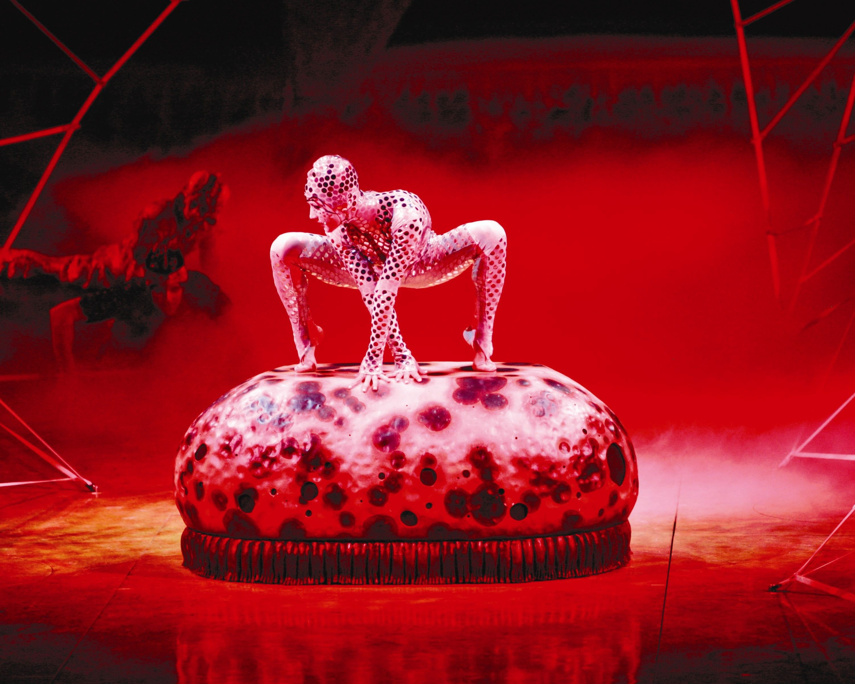
Vocabulary
Chuck – бросать,кидать
Swell – важная шишка
Dud – липа
Incommode – беспокоить
Pertinacity – неуступчивость
As tight as drums – мертвецки пьяный

Slide 5
Questions for discussion
Does Stella’s husband love her?
Did Stella die in the end?
Why did Stella decide to jump the second time anyway?
What are the main issues this short story raises?
Why do you think the old couple came to see them?
Why do you think people seek adrenalin through similar means?For instance,watching horrors or doing extreme types of sports?

Slide 6
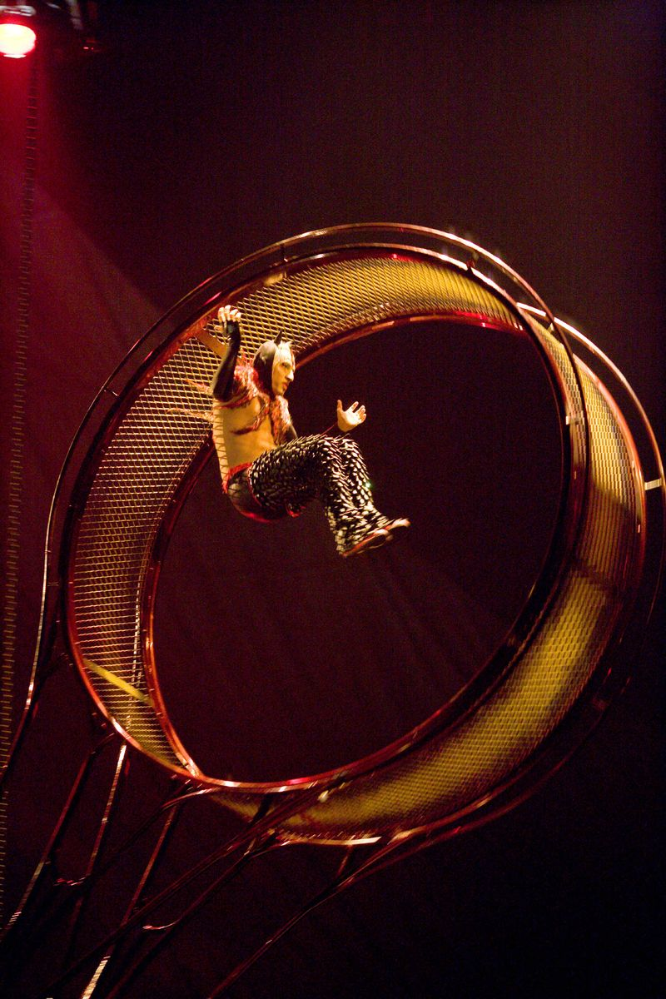
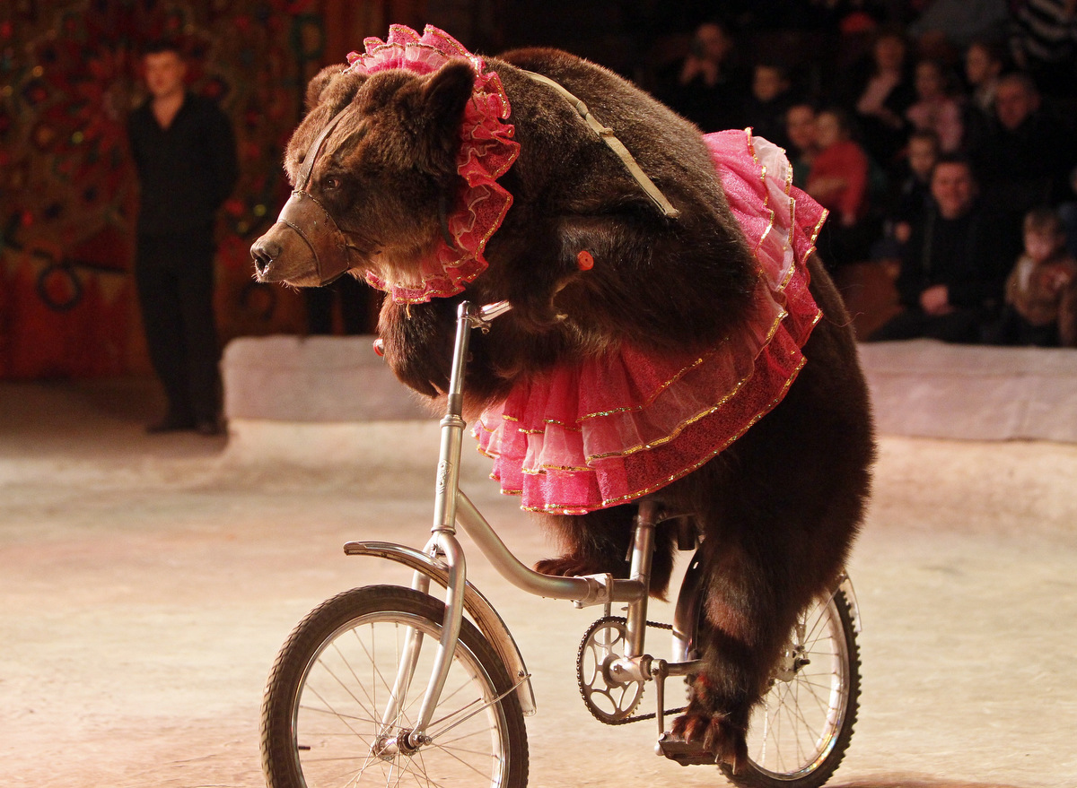
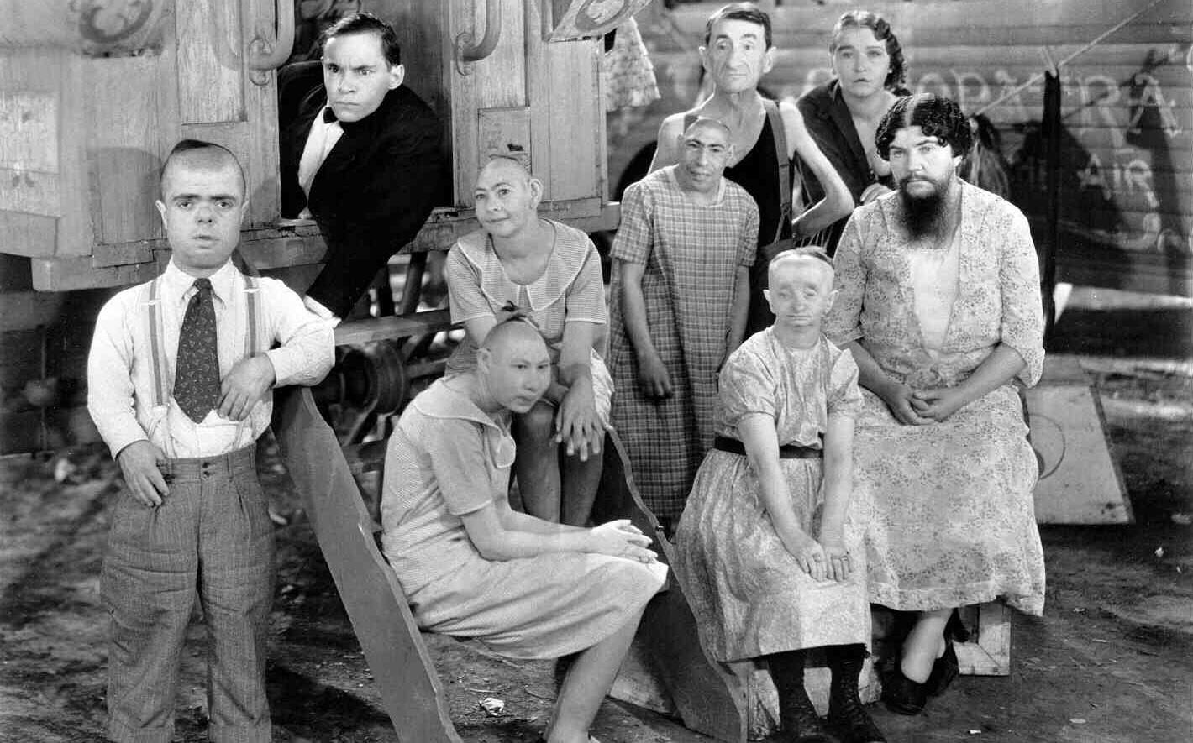
Associations

Slide 7
Thank you for the attention!

