Slide 1
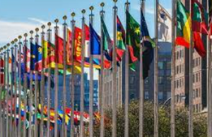
VOCABULARY
QUIZ

Slide 2
p________ and
non-_______ members

Slide 3
permanent and
non-permanent members

Slide 4
to debate issues on
s _ _ _ _ _ _ _

Slide 5
to debate issues on security

Slide 6
to prevent conflict on a l _ _ _ _ s _ _ _ _

Slide 7
to prevent conflict on a large scale

Slide 8
to promote p _ _ _ _ and h _ _ _ _ r _ _ _ _ _

Slide 9
to promote peace and human rights

Slide 10
to foster c_________ and c____________

Slide 11
to foster communication and cooperation

Slide 12
to improve s__________ of l___________

Slide 13
to improve standards of living

Slide 14
h ________
p ________
c ________
to fight

Slide 15
hunger
poverty
child mortality
to fight

Slide 16
d_________ c__________

Slide 17
developing countries

Slide 18
l____ v__________

Slide 19
law violations

Slide 20
to g____ i__________

Slide 21
to gain independence

Slide 22
a___________ment

Slide 23
advancement

Slide 24
r_________ee

Slide 25
refugee

