Slide 1
‘Rain’ by Somerset Maugham
‘Outside, the pitiless rain fell, fell steadily, with a fierce malignity, that was all too human…’
Host: Yana Toporikova
Readers: Asya Igityan Christina Khomenko, Olga Ryzhova, Polina Kravtsova, Yanis Saulit

Slide 2
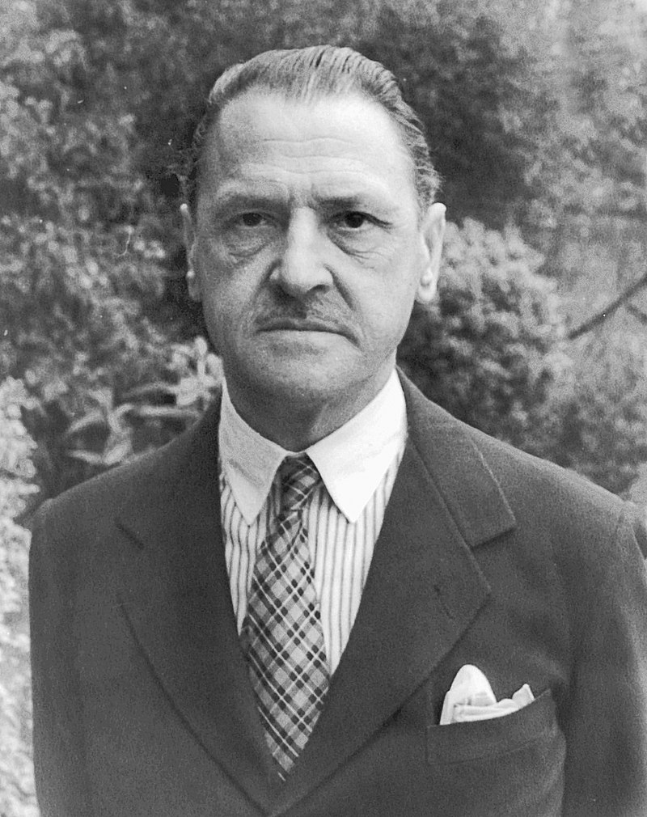
Maugham Somerset
William Somerset Maugham (5 January 1874 – 16 December 1965) was an English novelist, playwright and short – story writer.
Maugham was orphaned at the age of 10.
Maugham said he was agnostic to the questions concerning religion.
He was teased at school for his English.
In 1897, he published his first novel, Liza of Lambeth.
Maugham was qualified as a medic. He studied medicine at St Thomas's Hospital Medical School in Lambeth.

Slide 3
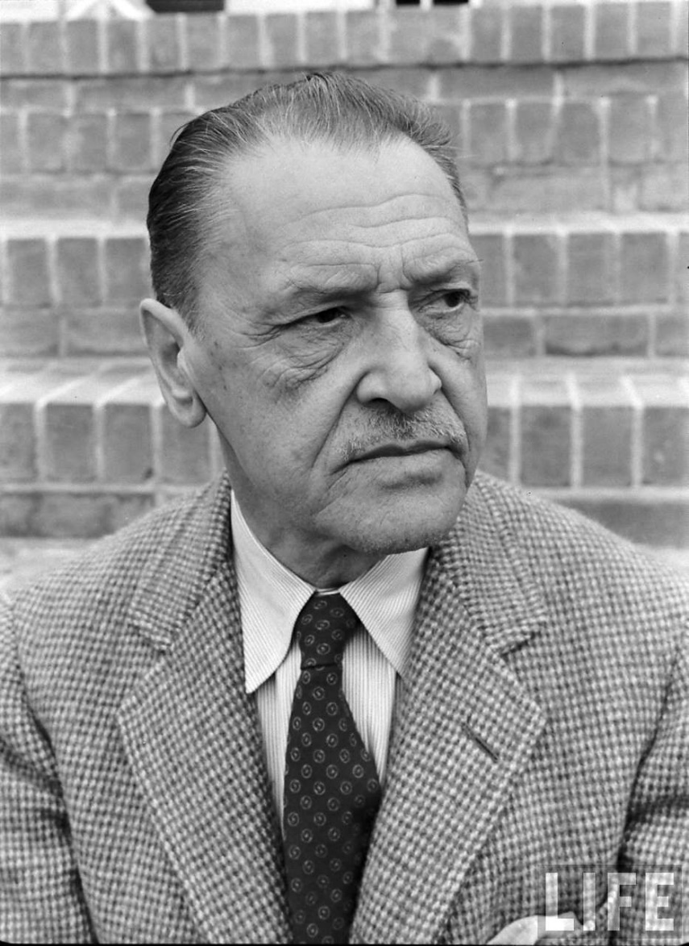
Career
Maugham worked in the British Secret Intelligence Service.
A lot of his books portray events taking place in India, Southeast Asia, China and the Pacific.
George Orwell said that Maugham was "the modern writer who has influenced me the most, whom I admire immensely for his power of telling a story straightforwardly and without frills".

Slide 4
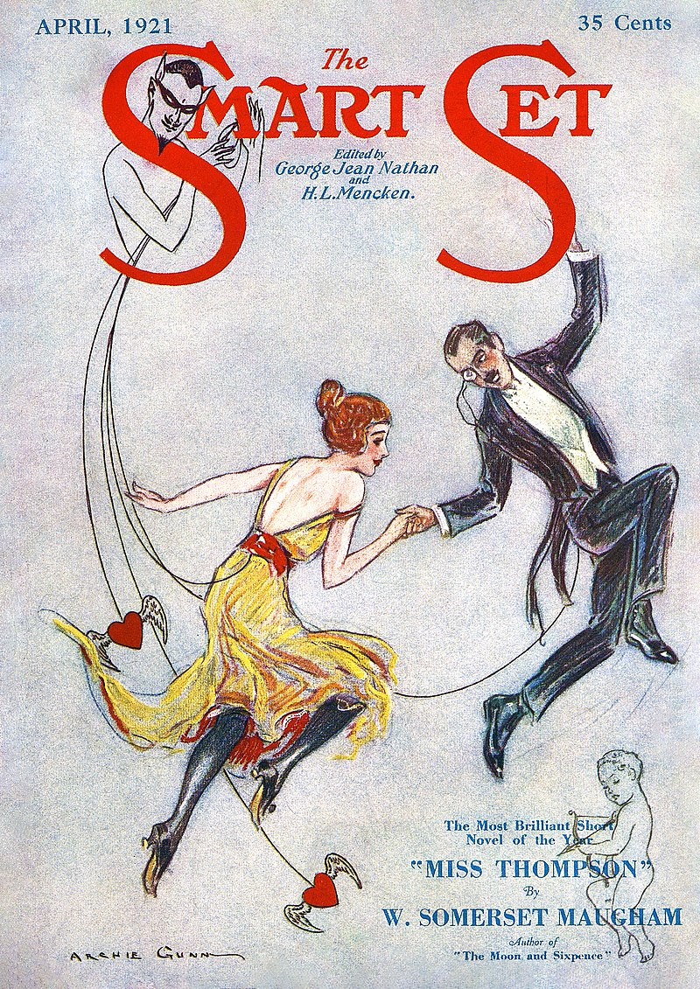
Plot and settings
The story takes place on a Pacific island.
In 1916 Maugham visited Pago – Pago, which is the capital of America Samoa.
There were lodgings who became prototypes for the heroes.
Main characters – the Davidsons (missionaries), the Macphails and Miss Thompson.

Slide 5
Quotes
“They can make a stand once, they can make a stand twice, but they can make a stand all the time..”
“…that was the most difficult part of my work, to instill into the natives the sense of sin.”
“You men! You filthy, dirty pigs! You’re all the same, all of you! Pigs! Pigs! “

Slide 6
Questions for discussion
An interesting fact is that the story was originally published as ‘Miss Thompson’ in 1921. Why do you think it was, however, the title ‘Rain’ that the story finally acquired?
The line of confrontation between the heroes runs throughout the story. In which conflicting principles or beliefs does this confrontation lie?
Compared to two sides of the coin, each character has a complicated and controversial inner world. How would you describe the main characters?

Slide 7
Questions for discussion
Mr.Davidson said: ‘The inhabitants of these islands will never be thoroughly Christianized till every boy of more than 10 years is made to wear a pair of trousers’. Do you think changing the way people dress can truly alter their religious beliefs? In your opinion, did Mr, Davidson sincerely mean good to natives while forcibly changing their nature and lifestyle?
Stories by Maugham Somerset are said to have a shrewd understanding of human nature. Does the story we’ve read confirm this opinion?

Slide 8
Messages
It’s not strict adherence to religion and austerity that make one a human, but deeds and attitude towards other people.
All people are sinful. We should forgive some of their vices, accept some of their blemishes and never persecute them trying to change their erring nature.
Be the change that you want to see in the world, mind your own business.

Slide 9
Messages
A person who seeks to eradicate sin in others must be prepares to resist it himself.
Sometimes there can be a fine line between holiness and deravity.

Slide 10
Thank you for your attention!

