Slide 1
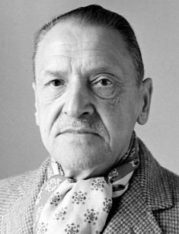
Maugham Somerset ‘Rain’

Slide 2
The plan
Author biography
Facts about the story
Characters
Plot and main the idea of the story
Expressions and quotes
Conclusion

Slide 3
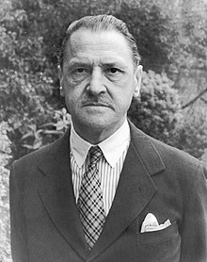
Somerset Maugham (1874-1965)
British Playwright, novelist and short story writer
his parents died before he was 10
studied literature, philosophy and German at Heidelberg University
After his return studied medicine
Was a member of the British red cross
‘Of human bondage’ is considered to be his masterpiece

Slide 4
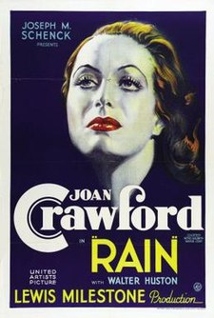
‘Rain’
Was based on the real story
It was first published as ‘Miss Thompson’
Was adapted into a play

Slide 5
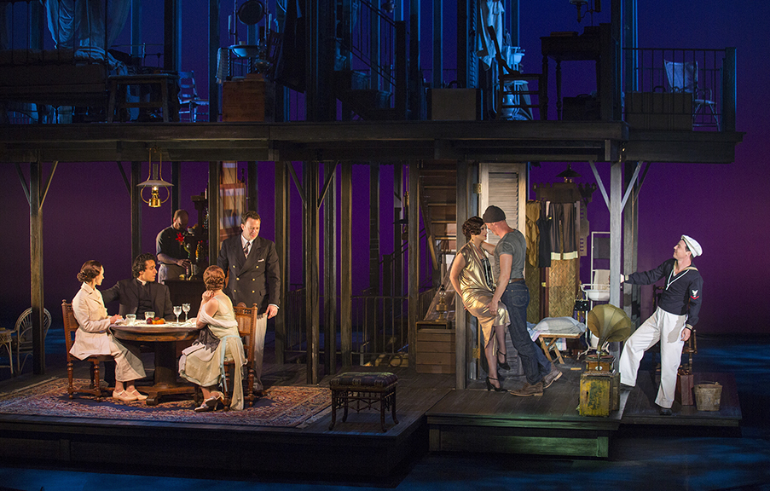
Characters
Dr. Macphail
Mrs. Macphail
Mr. Davidson
Mrs. Davidson
Miss Thomson
Mr. Horn
The governer

Slide 6
Plot and the main idea of the story
Questions to discuss:
1. Who was the main antagonist of the story?
2. Why is one of the characters a doctor and the other is a missionary?
3. What questions did the author want to raise in the story?
4. What is the main idea?

Slide 7
Expressions and quotes
‘I shouldn’t have thought a missionary was such a big bug he could afford to put on frills’. (Dr)
‘Terrible, ain’t it, bein’ cooped up in a one-horse burg like this?’ (Miss Thomson)
‘I think you are harsh and tyrannical’. (Dr)

Slide 8
Conclusion
https://www.youtube.com/watch?v=xeDZzgAx1EA

