Slide 1
The Pool by W.S.Maugham Host: Alexandra Kolesnik

Slide 2
The quote
“One of the best. Pity he drinks.” This from Chaplin was an observation not without humour.

Slide 3
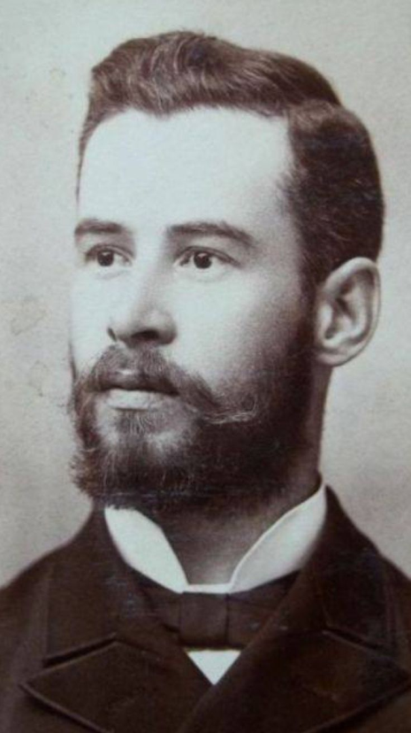
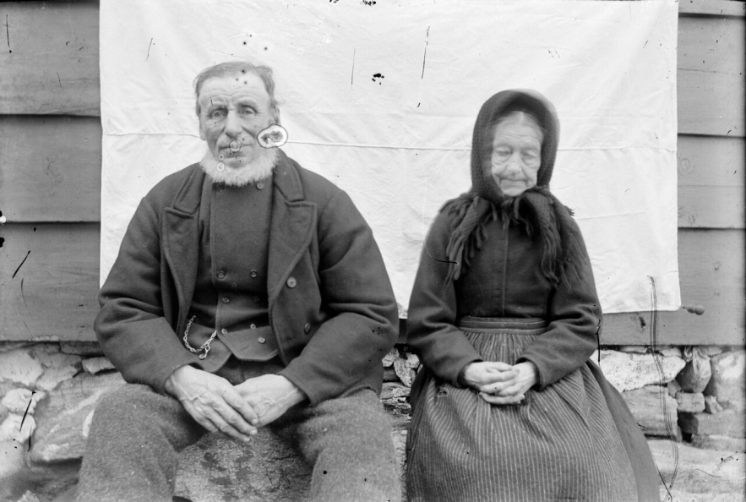
Characters

Slide 4
The lines
Ethel – Lawson
Lawson – the Ethel’s family
Lawson – sons
Lawson – the society
Lawson – the Pool
Lawson – Home

Slide 5
I was a link with the world he regretted and a life that he would know no more.

Slide 6
The message
Don’t judge people by their appearance and behavior. Everyone you meet is fighting a battle you know nothing about.
Throw away the prejudices.
People are tied with their homelands. These ties are stronger than one can imagine.
Be strong to accept mistakes and be eager to correct them. No matter how hard it is, the life is worth being continued.
Nobody can change other people’s mind. Act according to the moral and the honor, don’t seek for approval.

Slide 7
How could it happen, when an ideal life with the True Love turns into the Hell on Earth?
Why is it necessary to hurt people who love you?
Egoism or misunderstanding?
“Go away,” she shrieked.“I won’t have you here.Can’t you even leave me this? Go away.”

Slide 8
The author’s view
It seems to me quite hard to extract Maugham’s view in the story, but I think he sympathizes with Lawson’s faith and tries to rise him up in readers’ eyes. He appears to be fed up with all the womanly fickleness that led in the story to a tragedy, with all these people who dare to judge, with all this society with their prejudices.

Slide 9
Associations
“Malena”

Slide 10
Thank you for your attention

