Slide 1
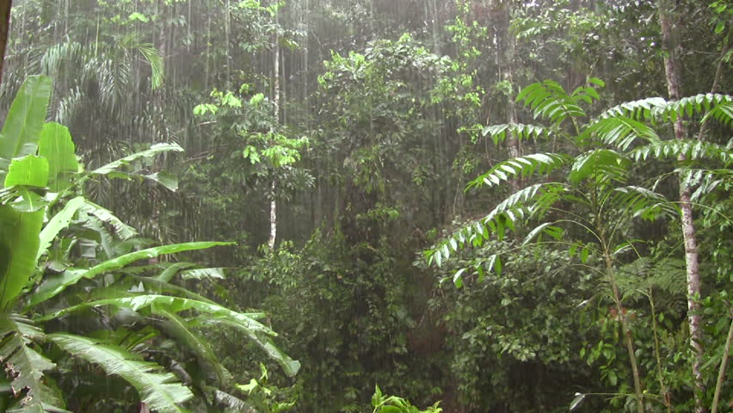
“Rain” by somerset maugham
Your host: Michael Bagach

Slide 2
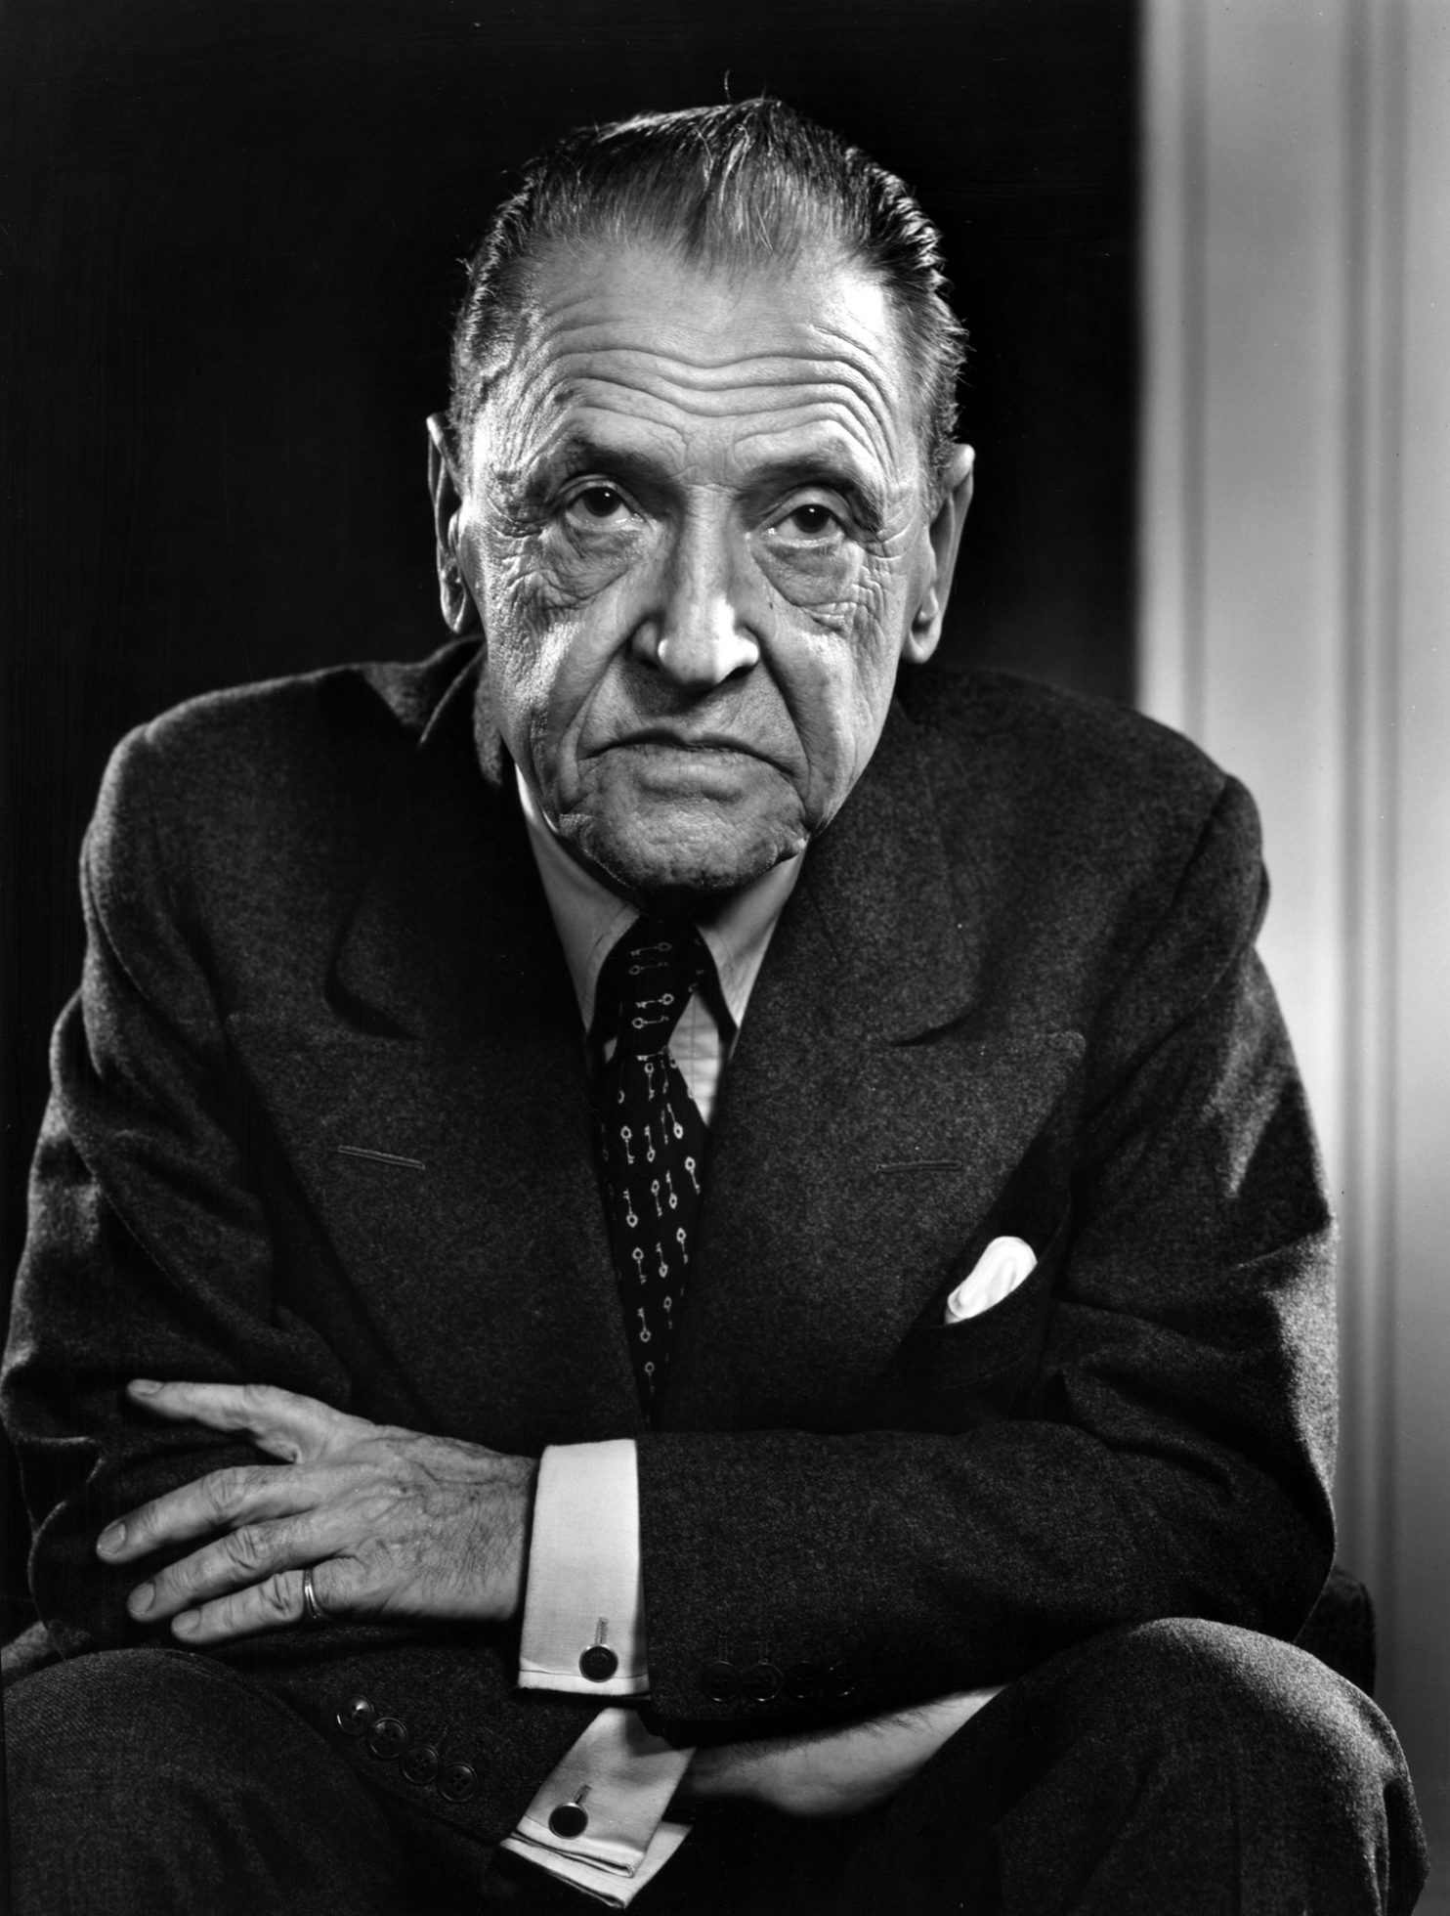
The author: short facts
Somerset Maugham was born in Paris in 1874 and died in Nice in 1965
He was a spy for the british MI5. This profession inspired many of his works.
Maugham traveled a lot to find inspiration for his works. He visited Russia, the American Samoa, China, the USA and many other countries and places.

Slide 3
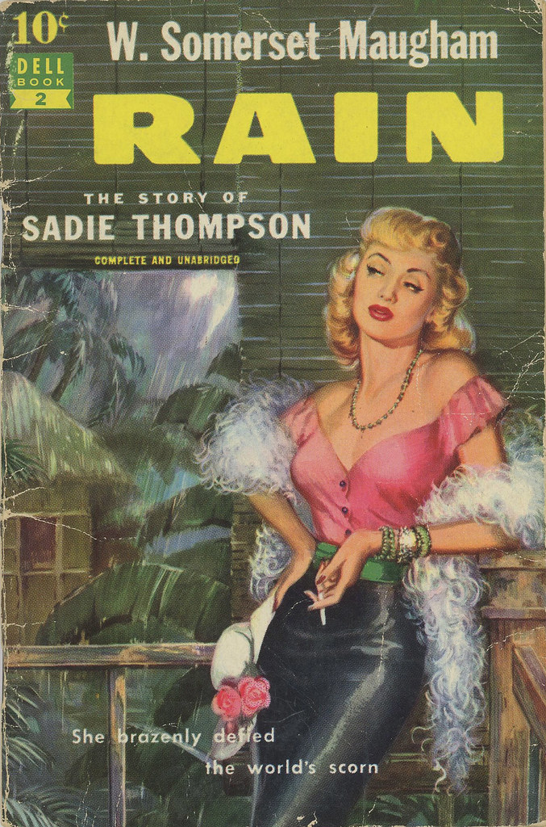
“Rain”: context, inspiration
This short story was born directly from the notes that Maugham took while on his tour of the Pacific
During a delay because of a quarantine inspection Maugham and his secretary had to take lodgings in Pago Pago, the capital of American Samoa
In these lodgings Maugham encountered a “Miss Thompson” (she was there for a job as barmaid in Apia) and a couple of medical missionaries, who became the models for the story.

Slide 4
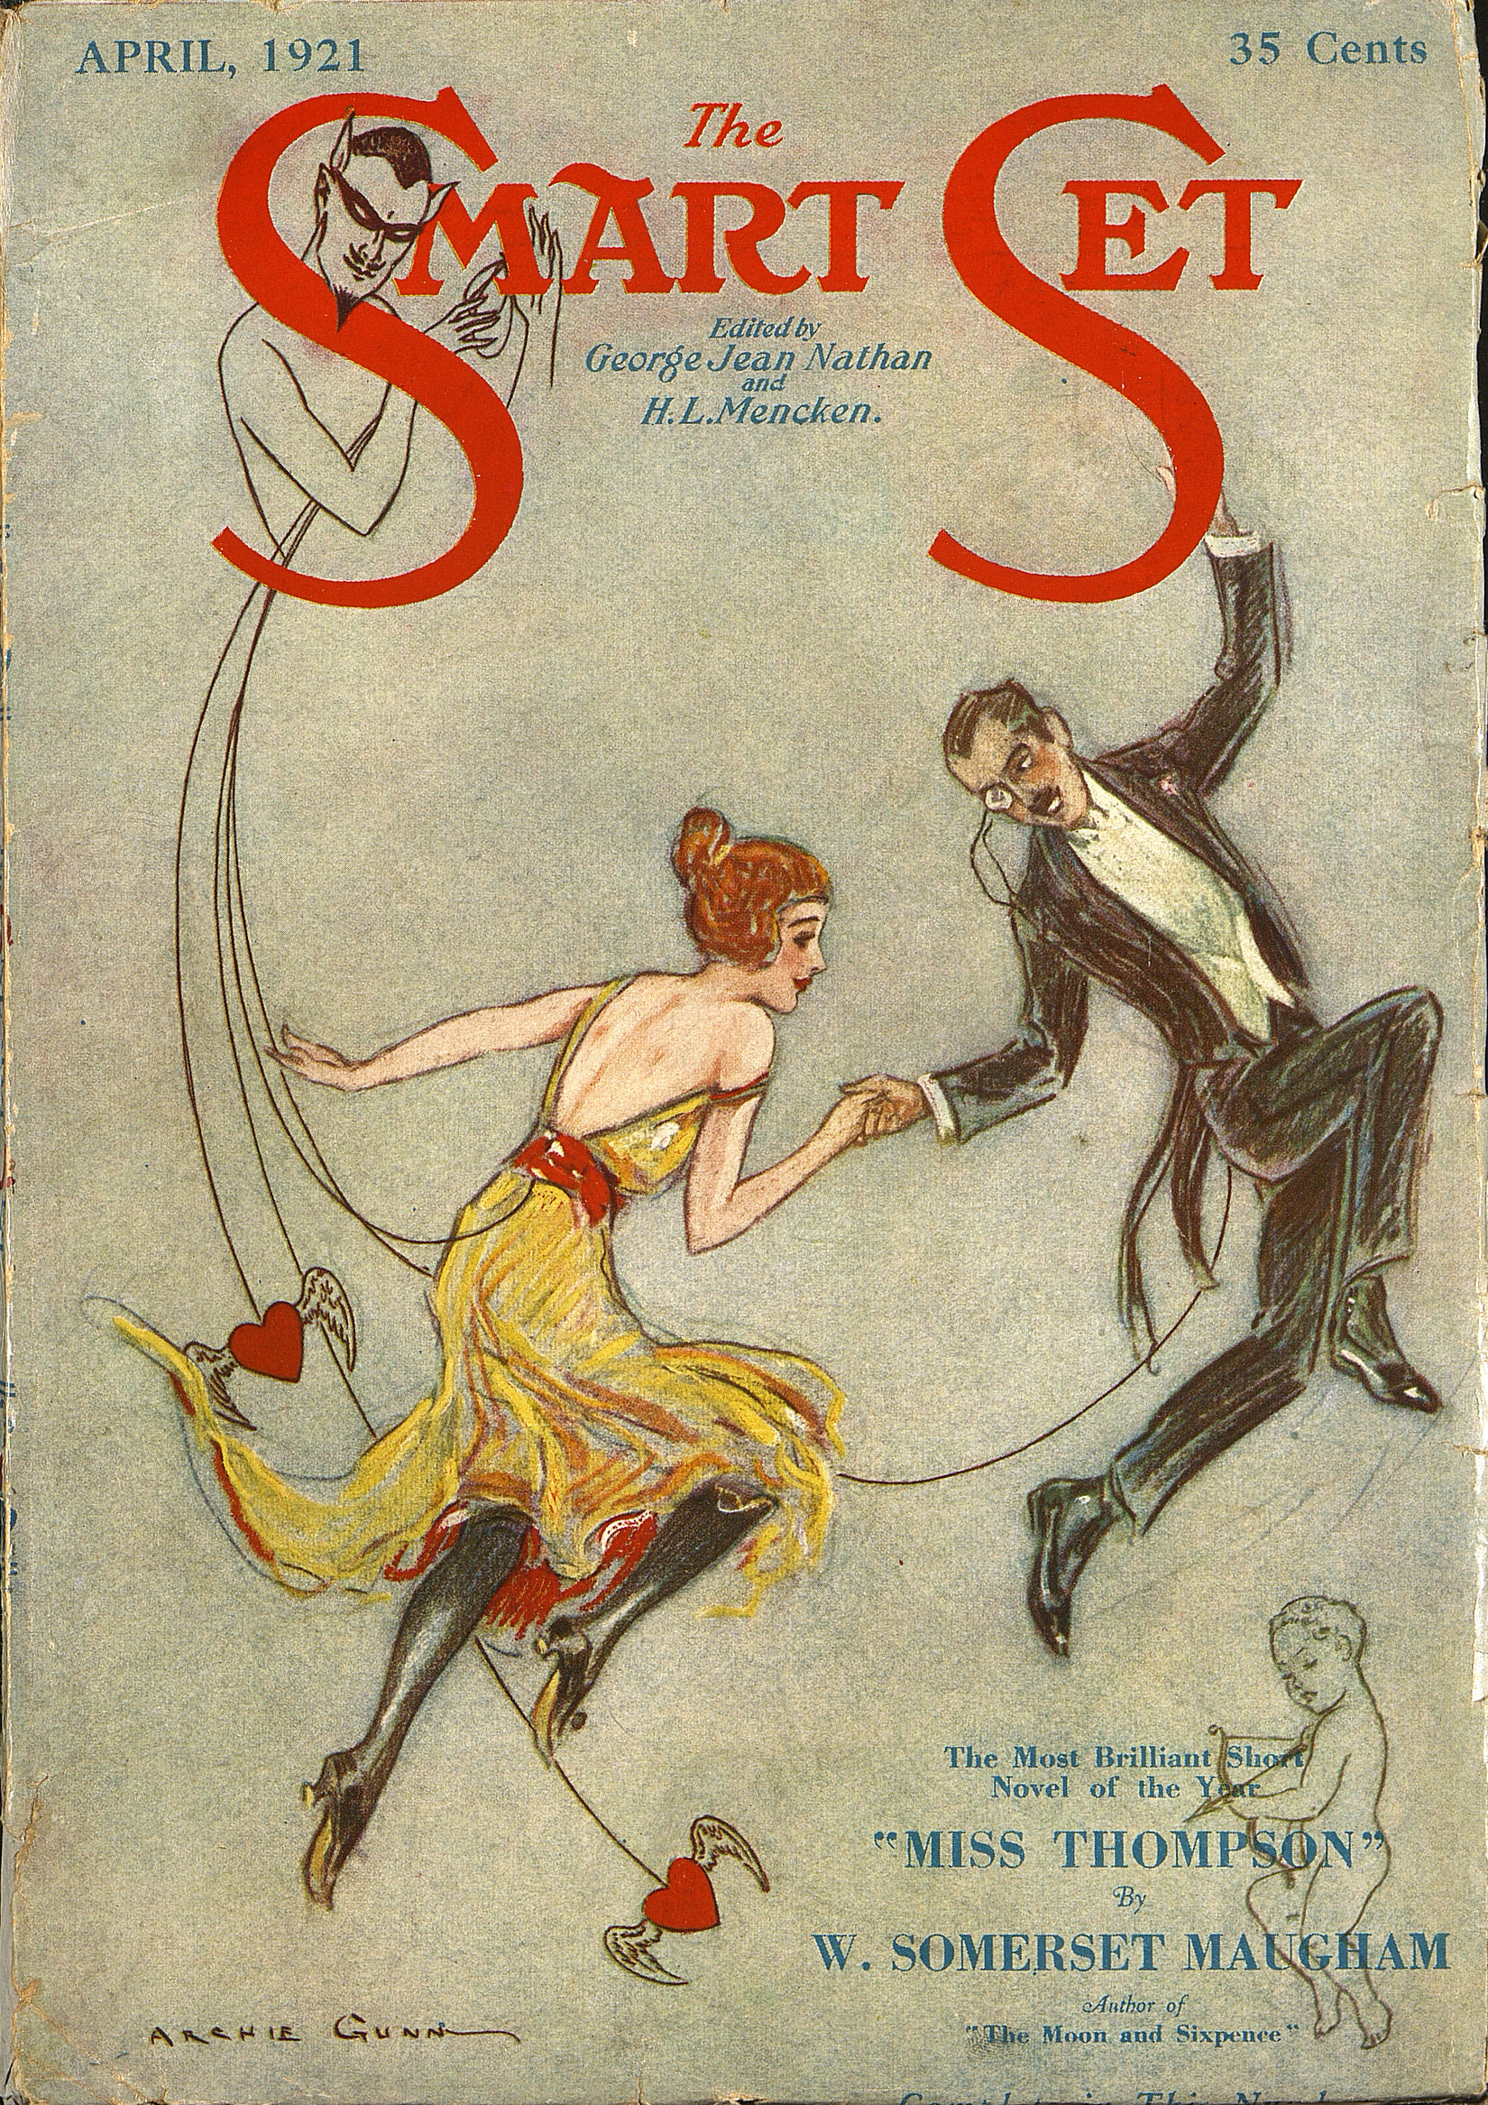
The characters
Dr. Mcphail
Mrs. Mcphail
Mr Davidson
Mrs Davidson
Miss Thompson
Mr Horn
The governor

Slide 5
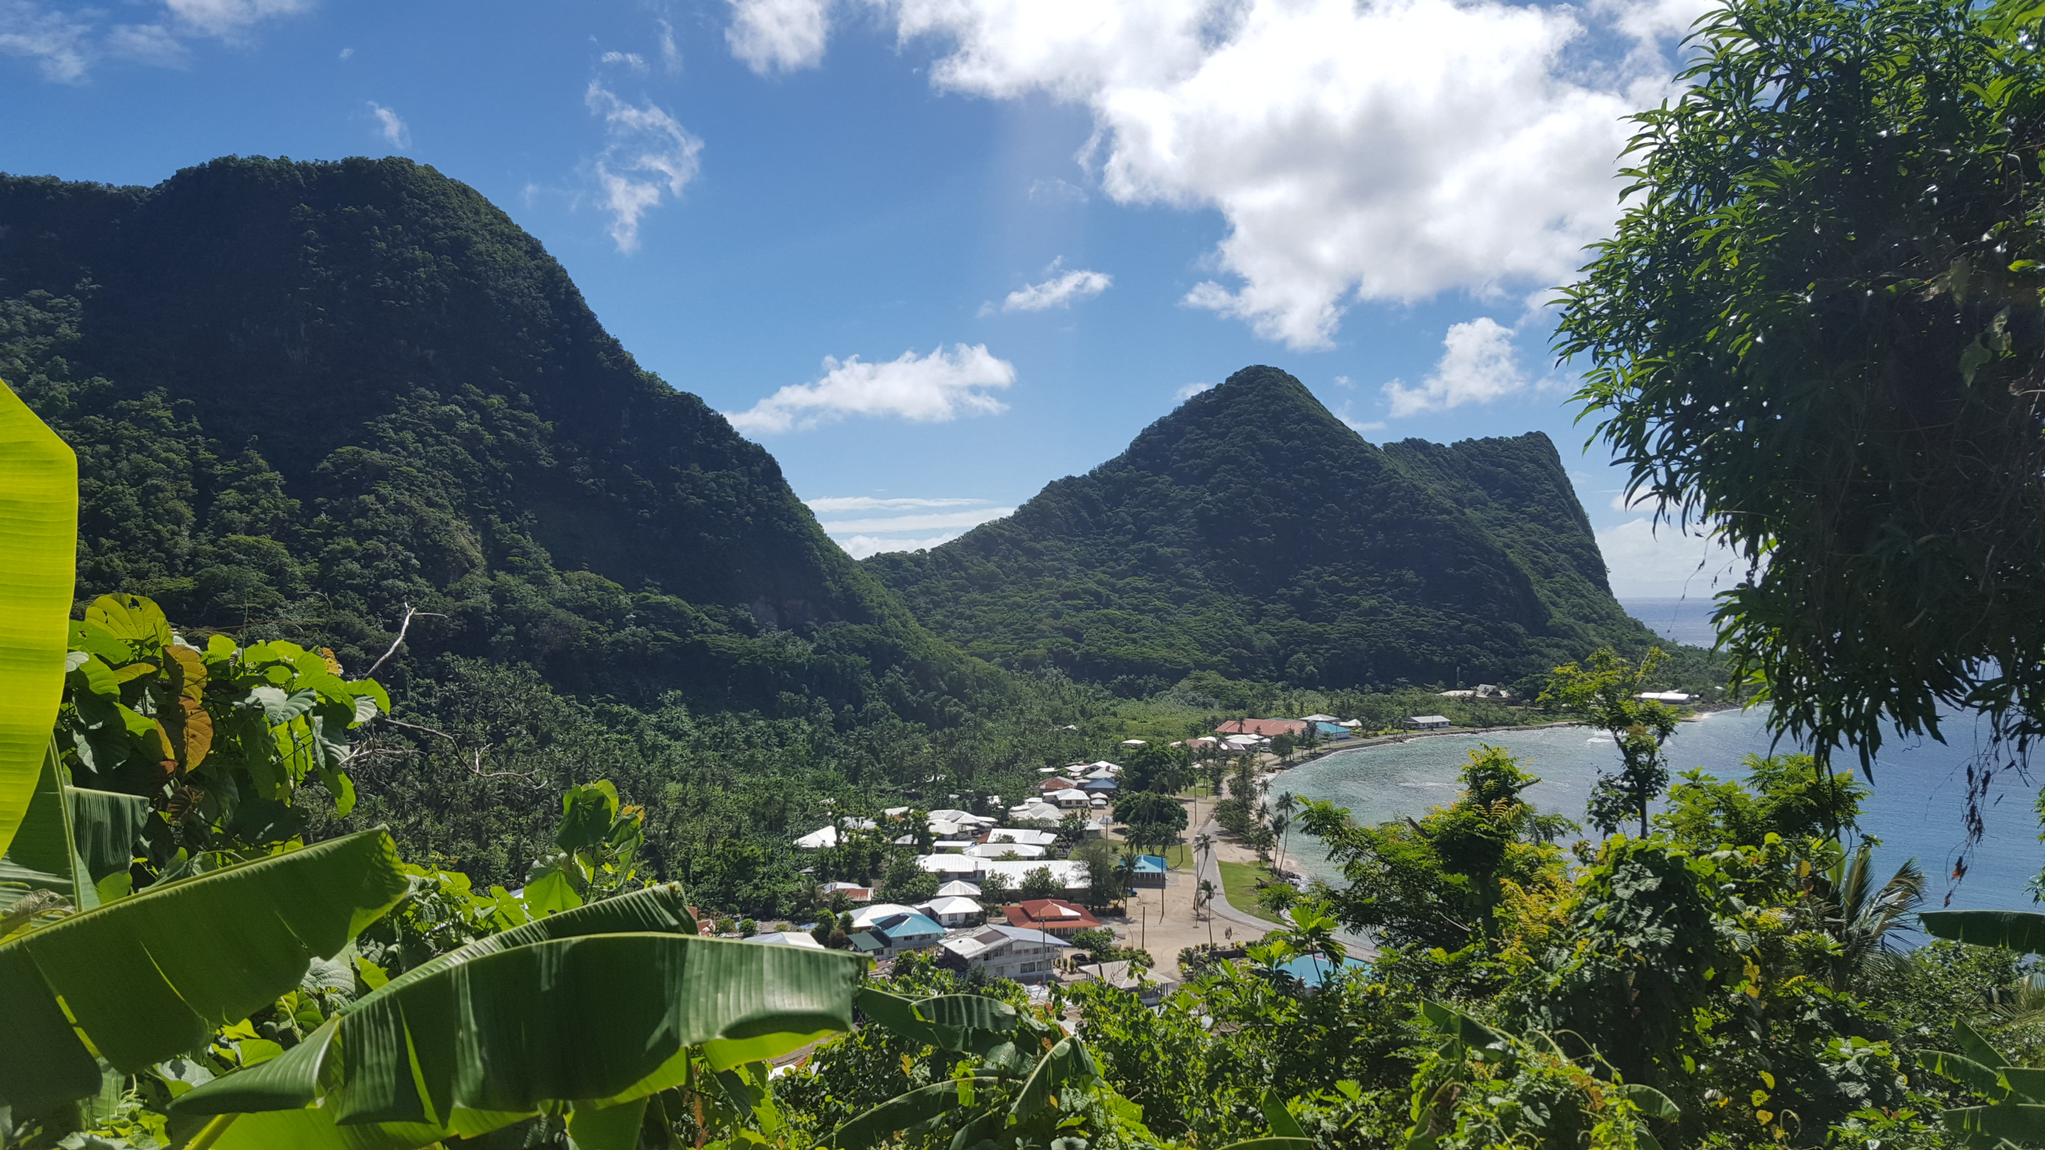
The Plot

Slide 6
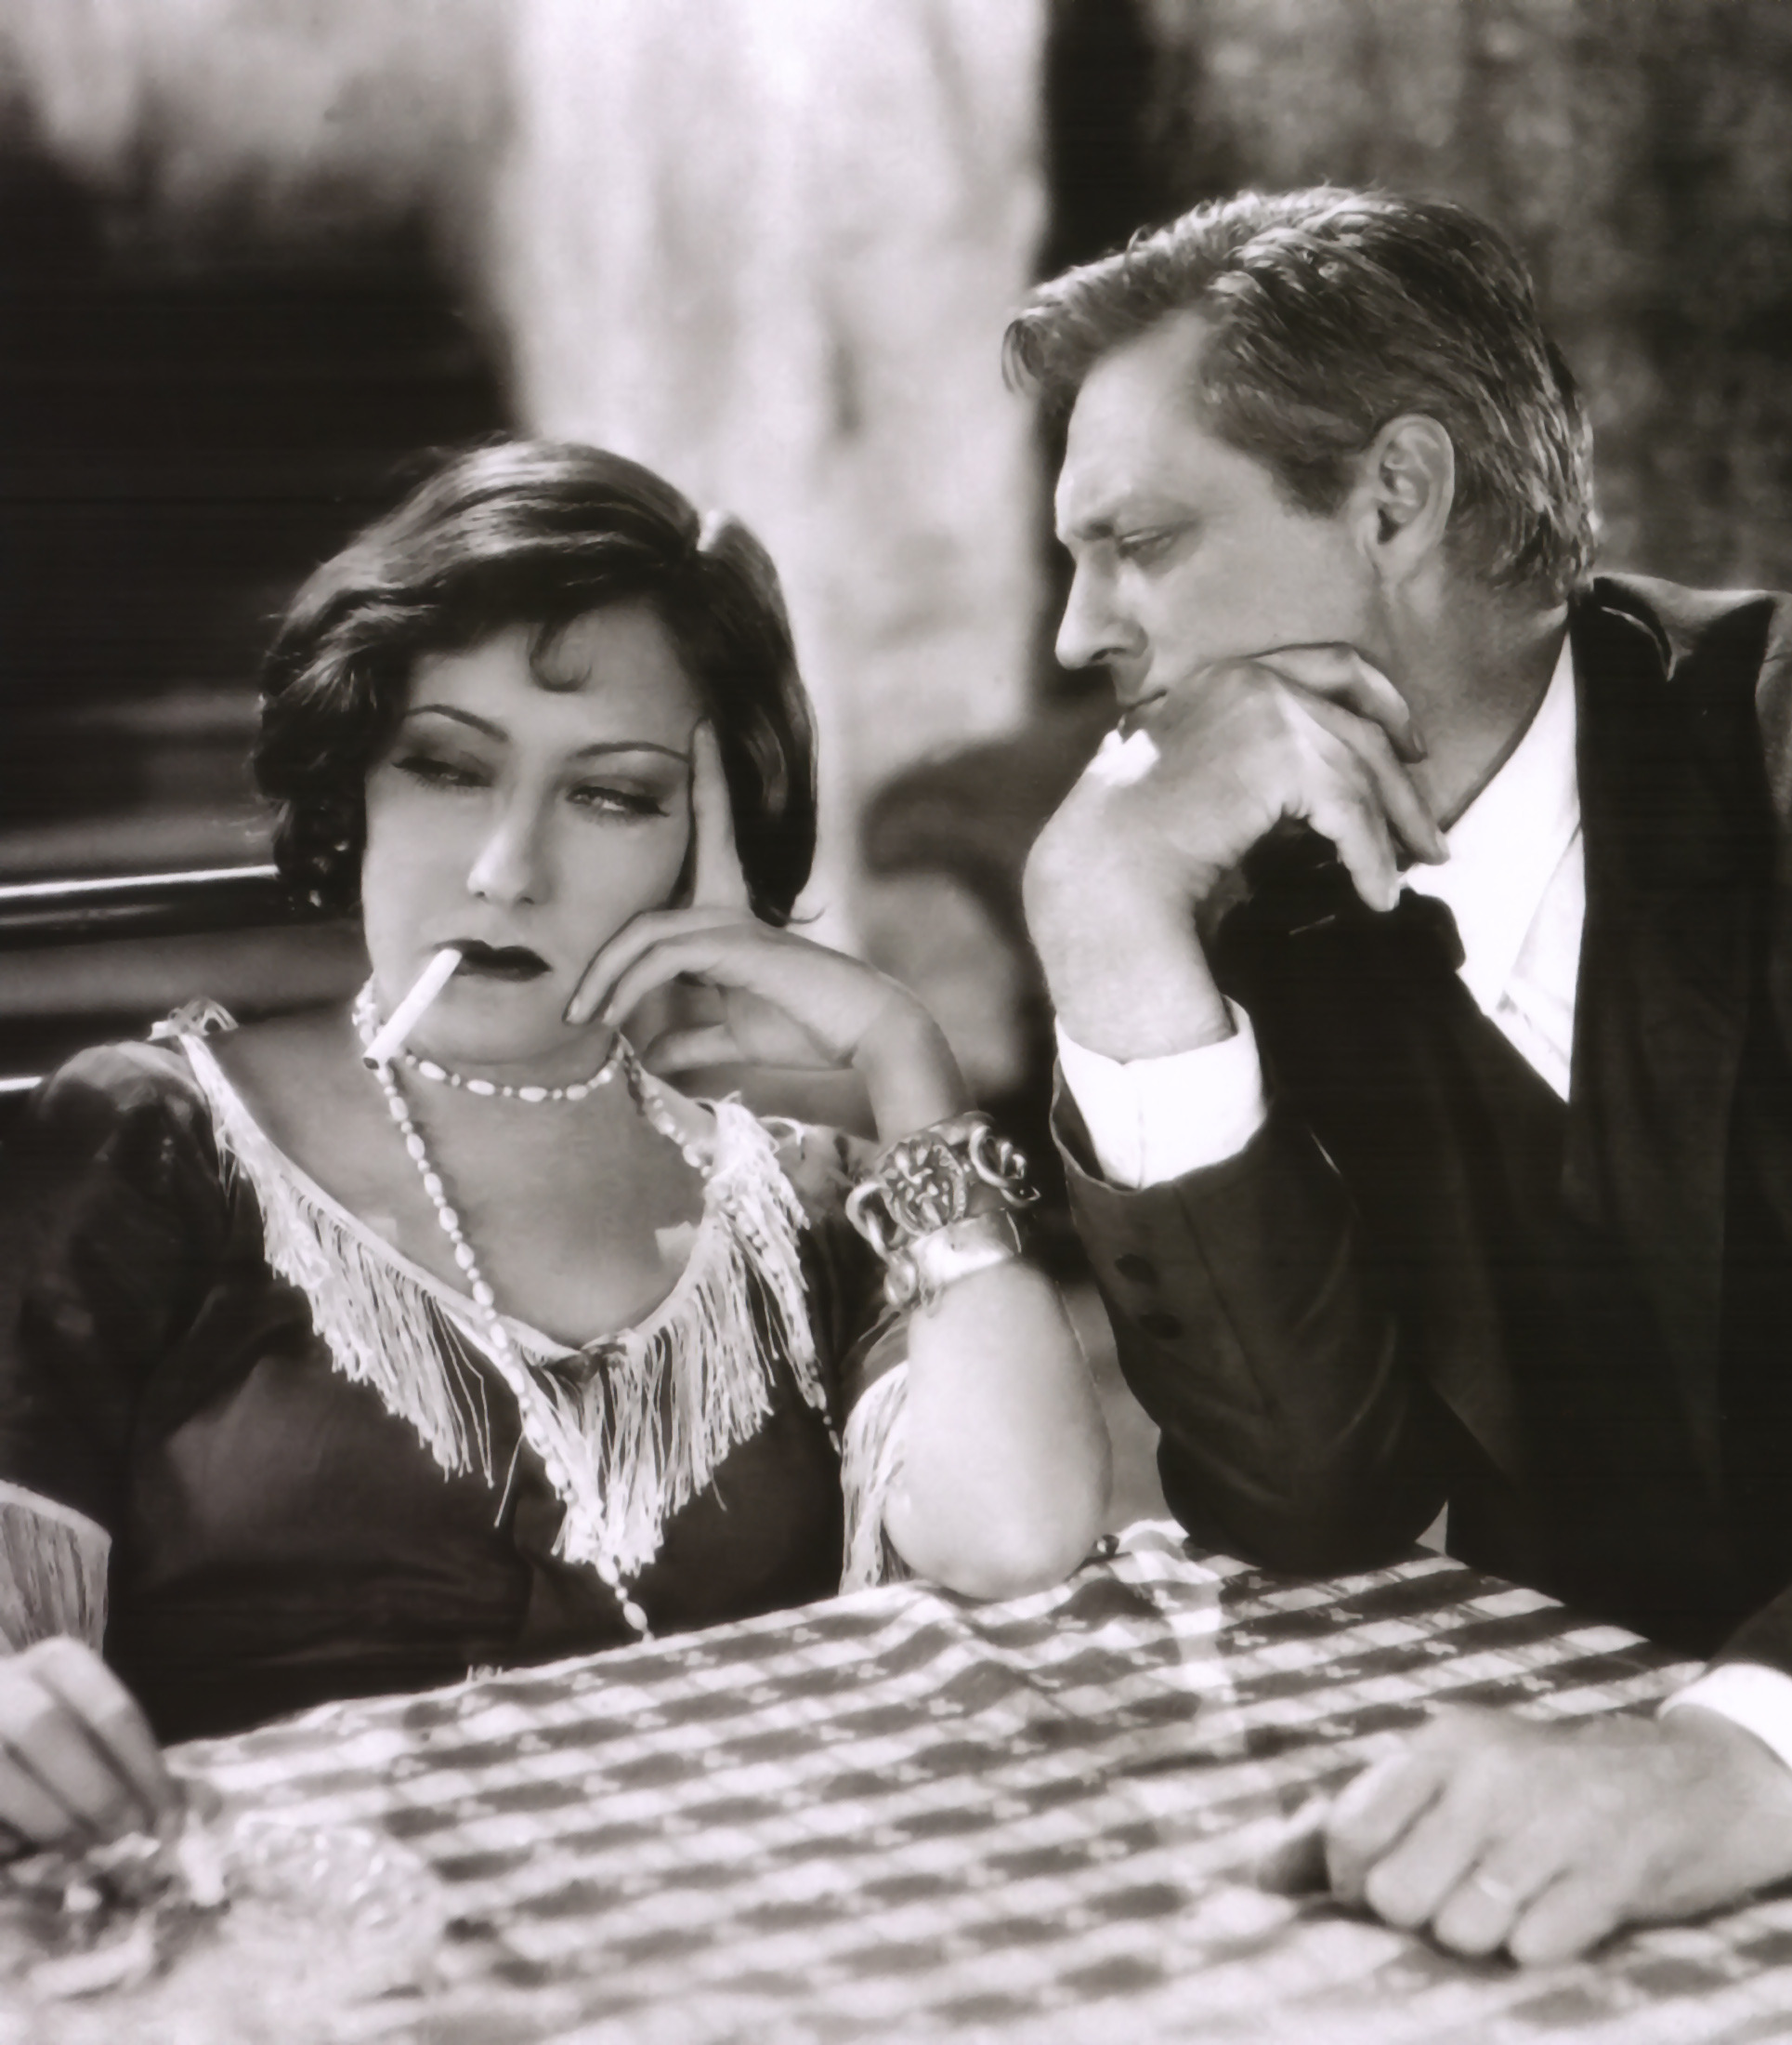
The moral
Maugham doesn’t try to impose a moralistic ending on the reader
The conflict of unyielding morality and cheerful vitality
You are the spectator of the conflict
No matter how strong the morality, in it’s conflict with life, life will prevail

Slide 7
The quote
“She gathered herself together. No one could describe the scorn of her expression or the contemptuous hatred she put into her answer. ‘You men! You filthy dirty pigs! You’re all the same, all of you. Pigs! Pigs!’”

Slide 8
Discussion questions
Why is the title of the story “Rain”?
On what side of the conflict would you be? The oppressed Miss Thompson or the pious Reverend Davidson?
What is the standpoint of the “wives”?

Slide 9
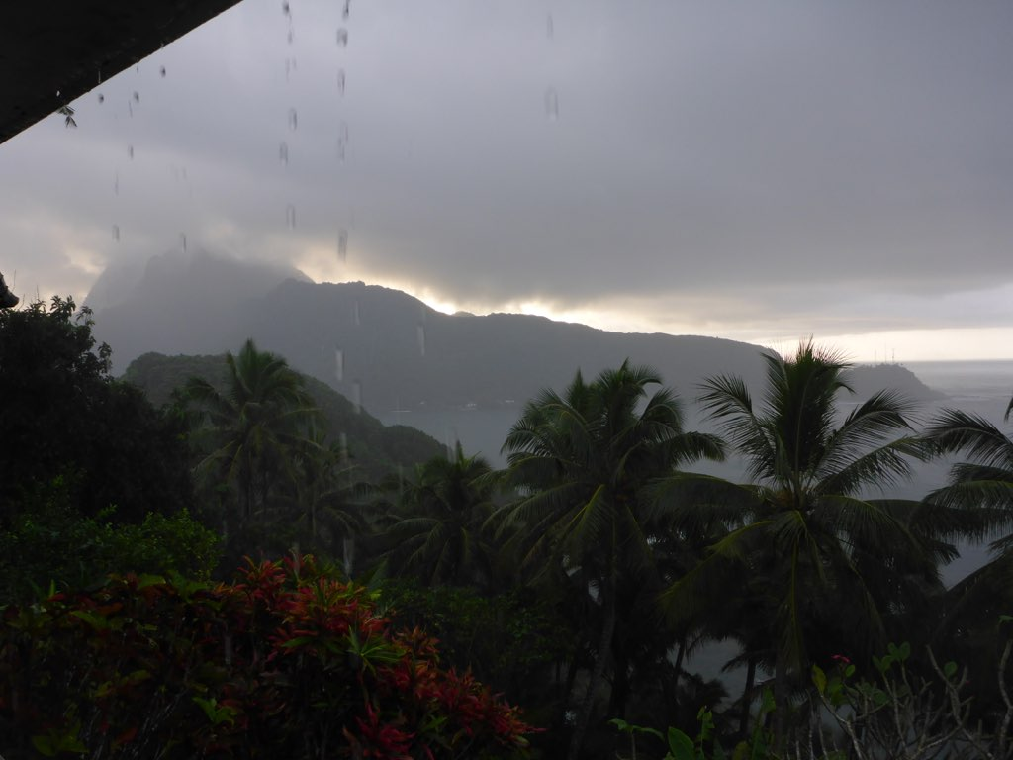
Thank you for your attention

